Slide 1
GENERALLY ACCEPTED ACCOUNTING PRINCIPLES (GAAP)
Generally Accepted Accounting Principles (GAAP) refer to the rules or guidelines adopted for recording and reporting of business transactions of financial statements.
These principles have evolved over a long period of time on the basis of past experiences, usages or customs, etc.
These principles are also referred as concepts and conventions, which have already been discussed.

Slide 2
ACCOUNTING STANDARDS
The term standard denotes a discipline, which provides both guidelines and yardsticks for evaluation.
The Institute of Chartered Accountant of India (ICAI) constituted the Accounting Standards Board (ASB) in April, 1977 for developing accounting standards

Slide 3
The Accounting Standards Board is entrusted with the responsibility of formulating standards on significant accounting matters keeping in view the international developments, and legal requirements in India.
The main function of the ASB is to identify areas in which uniformity in standards is required and to develop draft standards after discussions with representatives of the Government, public sector undertaking, industries and other agencies.

Slide 4
Till date, the IASC has brought out 40 accounting standards. However, the ICAI has so far issued 29 accounting standards. These are

Slide 5
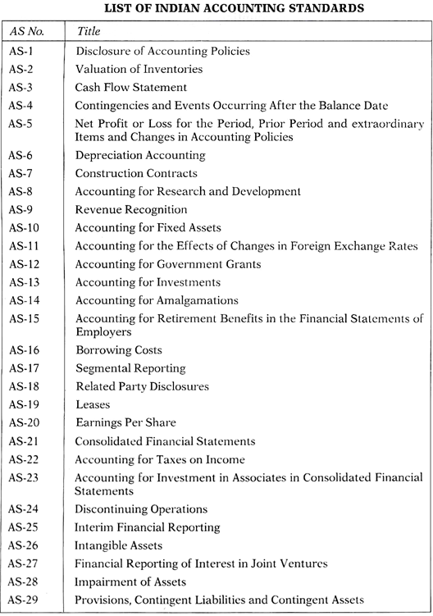

Slide 6
Note :
The following AS were withdrawn:
AS 6 – Depreciation Accounting
AS 8 – Accounting for Research and Development.

Slide 7
AS 1 Disclosure of Accounting Policies: This Standard deals with the disclosure of significant accounting policies which are followed in preparing and presenting financial statements.

Slide 8
AS 2 Valuation of Inventories: This Standard deals with the determination of value at which inventories are carried in the financial statements, including the ascertainment of cost of inventories and any write-down thereof to net realisable value.

Slide 9
AS 3 Cash Flow Statements: This Standard deals with the provision of information about the historical changes in cash and cash equivalents of an enterprise by means of a Cash Flow Statement which classifies cash flows during the period from operating, investing and financing activities.

Slide 10
AS 4 Contingencies and Events Occurring After Balance Sheet Date: This Standard deals with the treatment of contingencies and events occurring after the balance sheet date.

Slide 11
AS 5 Net profit or Loss for the period, Prior Period Items and Changes in Accounting Policies: This Standard should be applied by an enterprise in presenting profit or loss from ordinary activities, extraordinary items and prior period items in the Statement of Profit and Loss, in accounting for changes in accounting estimates, and in disclosure of changes in accounting policies

Slide 12
AS 7 Construction Contracts: This Standard prescribes the accounting for construction contracts in the financial statements of contractors.

Slide 13
AS 9 Revenue Recognition: This Standard deals with the bases for recognition of revenue in the Statement of Profit and Loss of an enterprise. The Standard is concerned with the recognition of revenue arising in the course of the ordinary activities of the enterprise from: a) Sale of goods; b) Rendering of services; and c) Interest, royalties and dividends.

Slide 14
AS 10 Property, Plant and Equipment / Accounting for Fixed Assets : The objective of this Standard is to prescribe the accounting treatment for property, plant and equipment (PPE).

Slide 15
AS 11 The Effects of Changes in Foreign Exchange Rates: AS 11 lays down principles of accounting for foreign currency transactions and foreign operations, i.e., which exchange rate to use and how to recognise in the financial statements the financial effect of changes in exchange rates

Slide 16
AS 12 Government Grants: This Standard deals with accounting for government grants. Government grants are sometimes called by other names such as subsidies, cash incentives, duty drawbacks, etc.

Slide 17
AS 13 Accounting for Investments: This Standard deals with accounting for investments in the financial statements of enterprises and related disclosure requirements.

Slide 18
AS 14 Accounting for Amalgamations: This Standard deals with accounting for amalgamations and the treatment of any resultant goodwill or reserves.

Slide 19
AS 15 Employee Benefits: The objective of this Standard is to prescribe the accounting treatment and disclosure for employee benefits in the books of employer except employee share-based payments. It does not deal with accounting and reporting by employee benefit plans.

Slide 20
AS 16 Borrowing Costs: This Standard should be applied in accounting for borrowing costs. This Standard does not deal with the actual or imputed cost of owners’ equity, including preference share capital not classified as a liability.

Slide 21
AS 17 Segment Reporting: The objective of this Standard is to establish principles for reporting financial information, about the different types of segments/ products and services an enterprise produces and the different geographical areas in which it operates.

Slide 22
AS 18 Related Party Disclosures: This Standard should be applied in reporting related party relationships and transactions between a reporting enterprise and its related parties. The requirements of this Standard apply to the financial statements of each reporting enterprise and also to consolidated financial statements presented by a holding company.

Slide 23
AS 19 Leases: The objective of this Standard is to prescribe, for lessees and lessors, the appropriate accounting policies and disclosures in relation to finance leases and operating leases.

Slide 24
AS 20 Earnings Per Share: AS 20 prescribes principles for the determination and presentation of earnings per share which will improve comparison of performance among different enterprises for the same period and among different accounting periods for the same enterprise.

Slide 25
AS 21 Consolidated Financial Statements: The objective of this Standard is to lay down principles and procedures for preparation and presentation of consolidated financial statements. These statements are intended to present financial information about a parent and its subsidiary(ies) as a single economic entity to show the economic resources controlled by the group, obligations of the group and results the group achieves with its resources.

Slide 26
AS 22 Accounting for Taxes on Income: The objective of this Standard is to prescribe accounting treatment of taxes on income since the taxable income may be significantly different from the accounting income due to many reasons, posing problems in matching of taxes against revenue for a period.

Slide 27
AS 23 Accounting for Investments in Associates: This Standard should be applied in accounting for investments in associates in the preparation and presentation of consolidated Financial Statements (CFS) by an investor

Slide 28
AS 24 Discontinuing Operations: The objective of AS 24 is to establish principles for reporting information about discontinuing operations, thereby enhancing the ability of users of financial statements to make projections of an enterprise’s cash flows, earnings generating capacity, and financial position by segregating information about discontinuing operations from information about continuing operations. AS 24 applies to all discontinuing operations of an enterprise.

Slide 29
AS 25 Interim Financial Reporting: This Standard applies if an entity is required or elects to publish an interim financial report. The objective of AS 25 is to prescribe the minimum content of an interim financial report and to prescribe the principles for recognition and measurement in complete or condensed financial statements for an interim period.

Slide 30
AS 26 Intangible Assets: AS 26 prescribes the accounting treatment for intangible assets (i.e. identifiable non-monetary asset, without physical substance, held for use in the production or supply of goods or services, for rental to others, or for administrative purposes).

Slide 31
AS 27 Financial Reporting of Interests in Joint Ventures: The objective of AS 27 is to set out principles and procedures for accounting for interests in joint ventures and reporting of joint venture assets, liabilities, income and expenses in the financial statements of venturers and investors.

Slide 32
AS 28 Impairment of Assets: The objective of AS 28 is to prescribe the procedures that an enterprise applies to ensure that its assets are carried at no more than their recoverable amount. The asset is described as impaired if its carrying amount exceeds the amount to be recovered through use or sale of the asset and AS 28 requires the enterprise to recognise an impairment loss in such cases. It should be noted that AS 28 deals with impairment of all assets unless specifically excluded from the scope of the Standard.

Slide 33
AS 29 Provisions, Contingent Liabilities and Contingent Assets: The objective of AS 29 is to ensure that appropriate recognition criteria and measurement bases are applied to provisions and contingent liabilities and that sufficient information is disclosed in the notes to the financial statements to enable users to understand their nature, timing and amount. The objective of this Standard is also to lay down appropriate accounting for contingent assets.

Slide 34
THANKS

